Slide 1
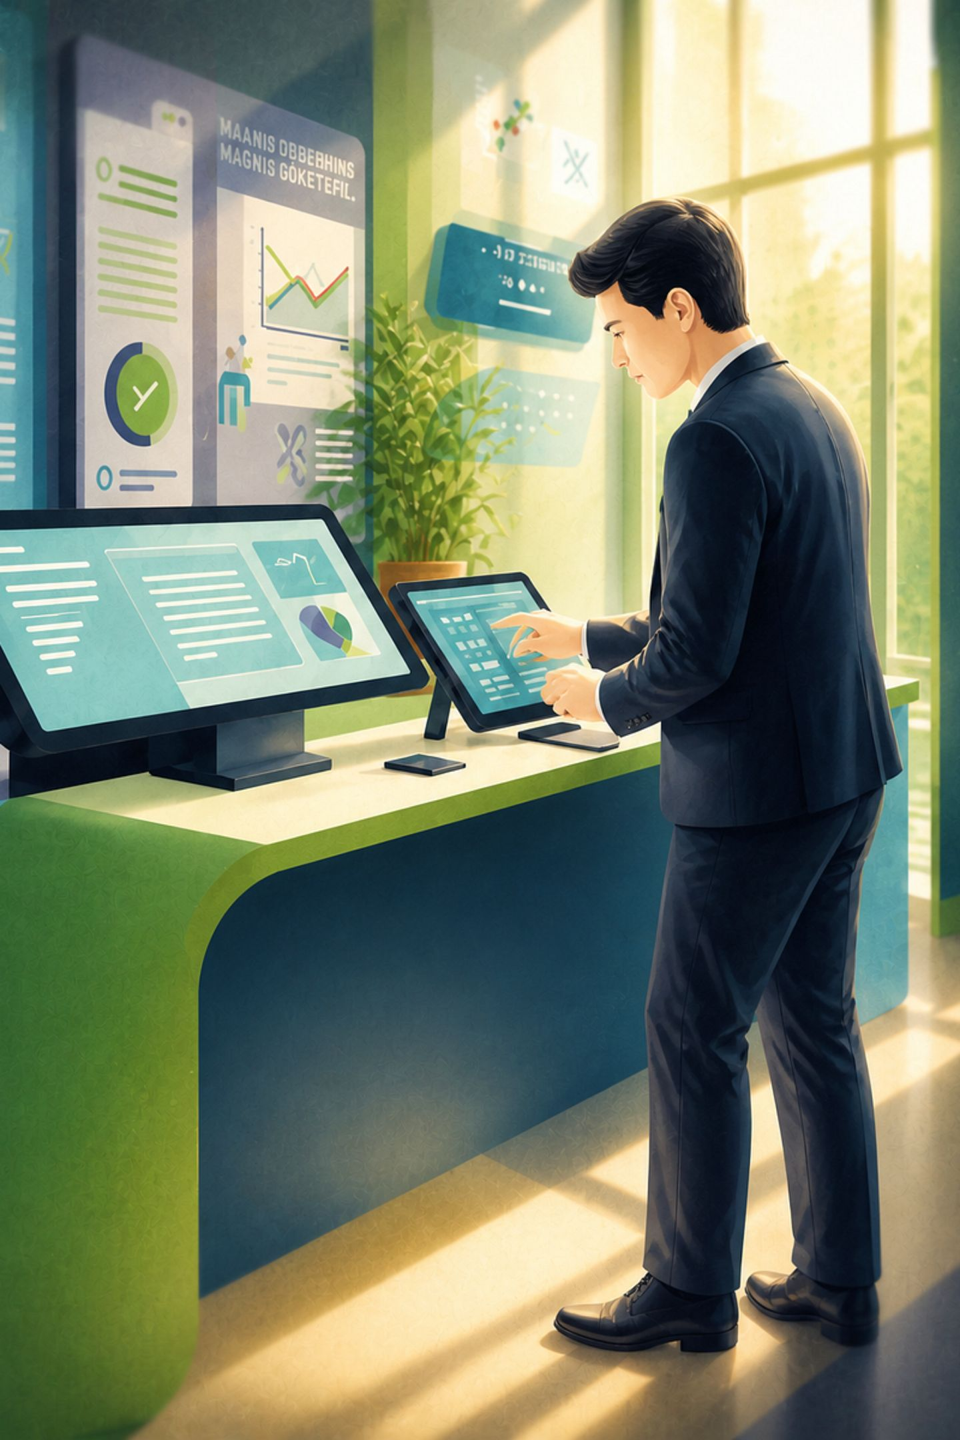
ReadSpace📚
A smart library system
Built by Team G6 to help libraries work better in the digital age.
TEAM G6
PITCH DECK 2026
Doaa Mohamed Adly Mohamed
Mariam Mohamed Mahmoud
Integration & QA Lead
Frontend / JavaScript
Ragaa Adel Elsayed Ibrahim
Hoda Ashraf Shabaan Mohamed
Frontend-templates&css
backend-models &admen
Zainab Salama Mohamed Tony
backend-auth

Slide 2

The Problem: Libraries Are Stuck in the Past
⏱ Time-Consuming
📉 No Visibility
Manual checkouts waste staff hours daily
Zero real-time data on inventory or loans
🔍 Hard to Find
📋 Error-Prone
Patrons can't search or filter catalogs easily
Paper records lead to costly mistakes
Outdated Tech Resources
Hard to track latest programming editions and tech stacks manually

Slide 3
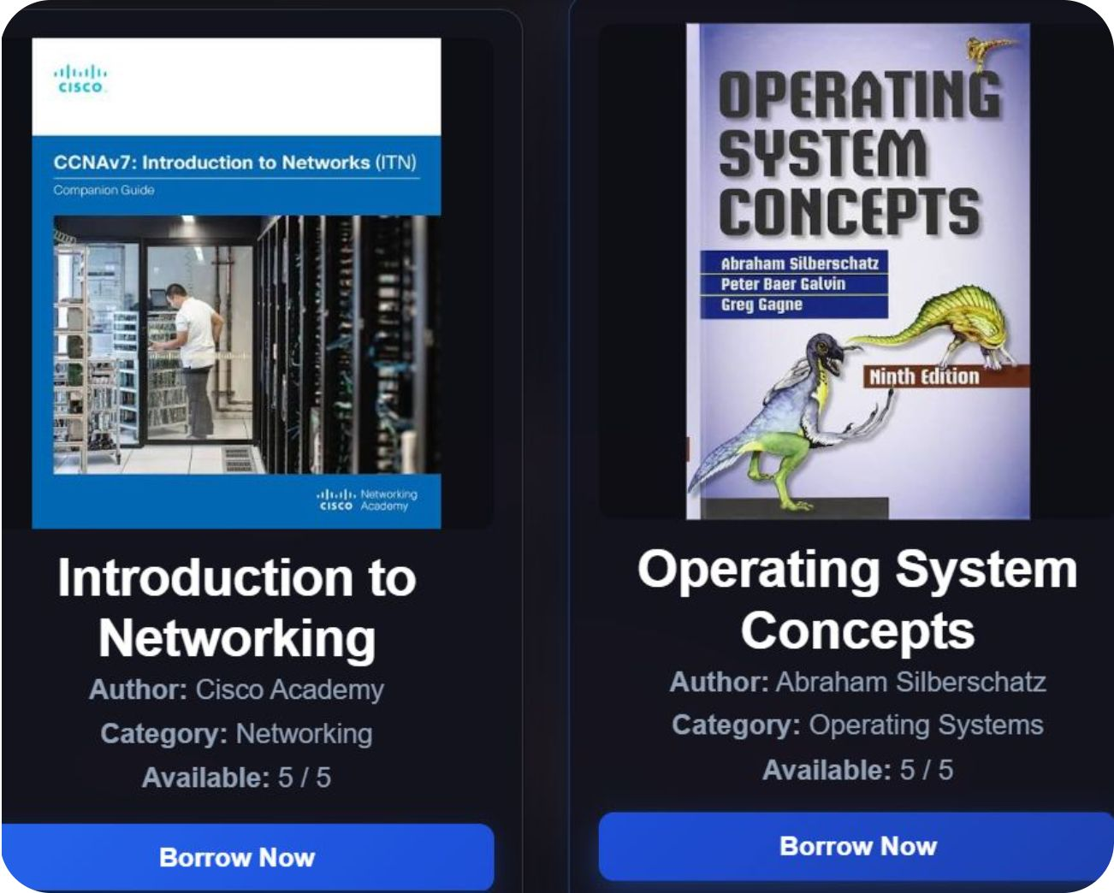
Introducing ReadSpace
One Platform. Total Control.
ReadSpace is a modern, end-to-end digital library system — designed for administrators and readers alike.
Real-time inventory at a glance
Instant search across the full catalog
Frictionless borrowing workflow
Secure user authentication

Slide 4
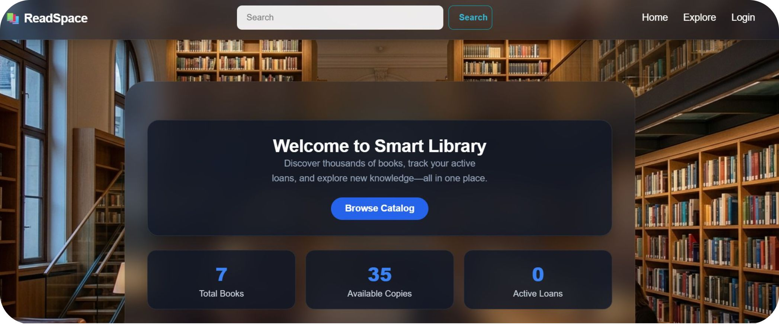
Core Features: Live Dashboard & Catalog
Live Stats Dashboard
Admins see Total Books, Available Copies, and Active Loans in real time — zero manual counting.
Explore & Search
Filter by category, author, or keyword. Find tech and programming books instantly.

Slide 5






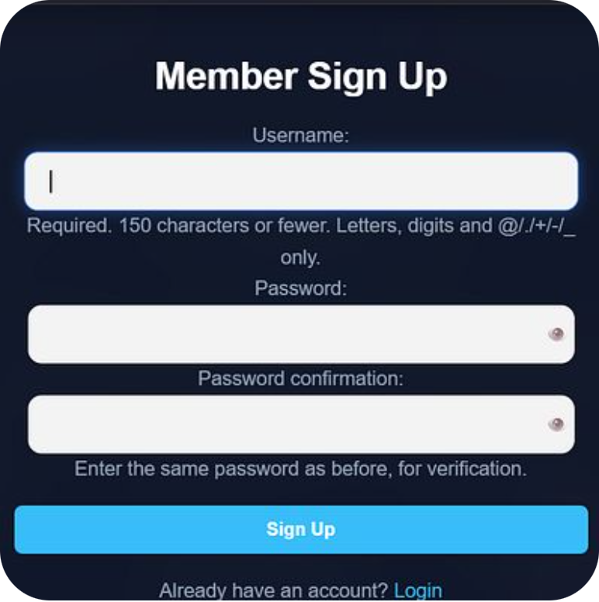
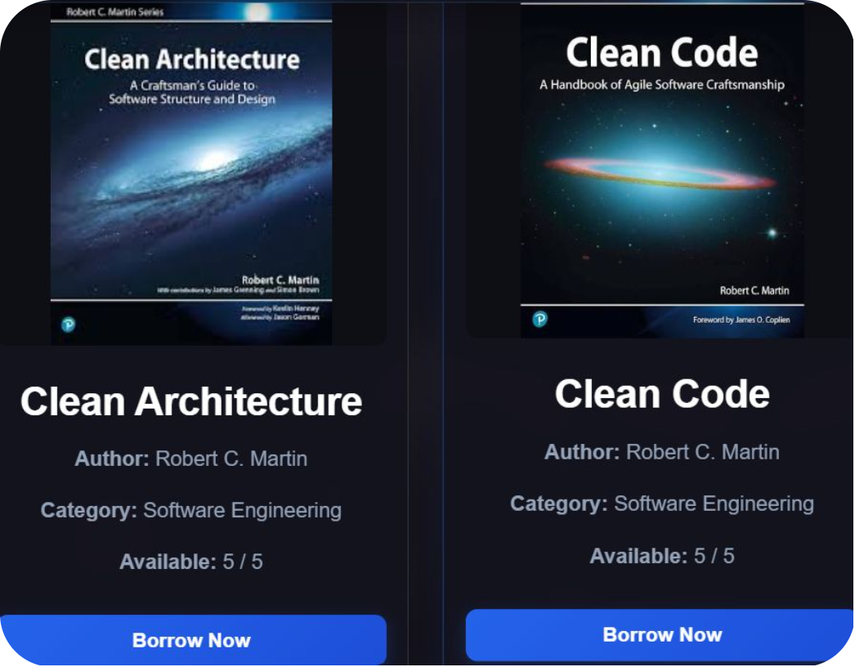
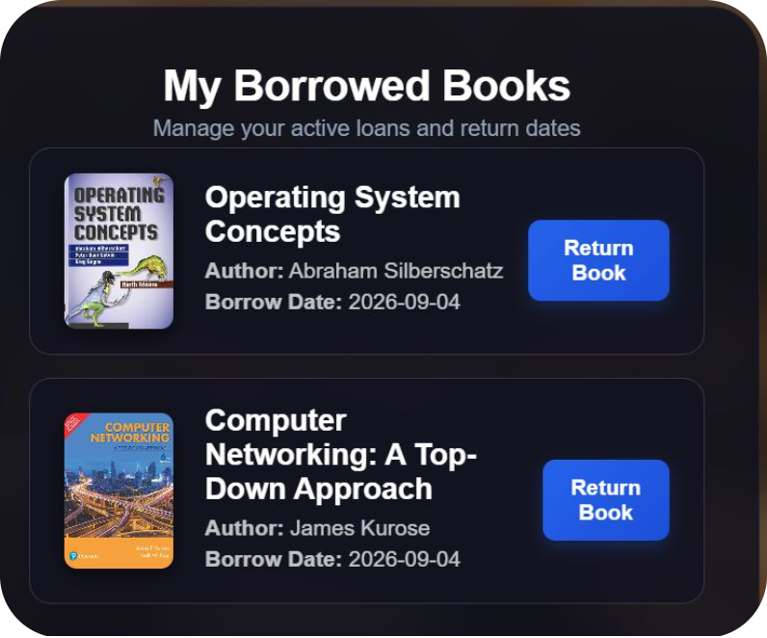
Core Features: Authentication & Borrowing
Seamless Authentication
Frictionless Borrowing
Automated Tracking
Sign up and member login — secure, fast, and intuitive for all users.
Borrow and return in seconds. Active loans and due dates tracked automatically.
Return dates and loan history managed without manual input from staff.

Slide 6
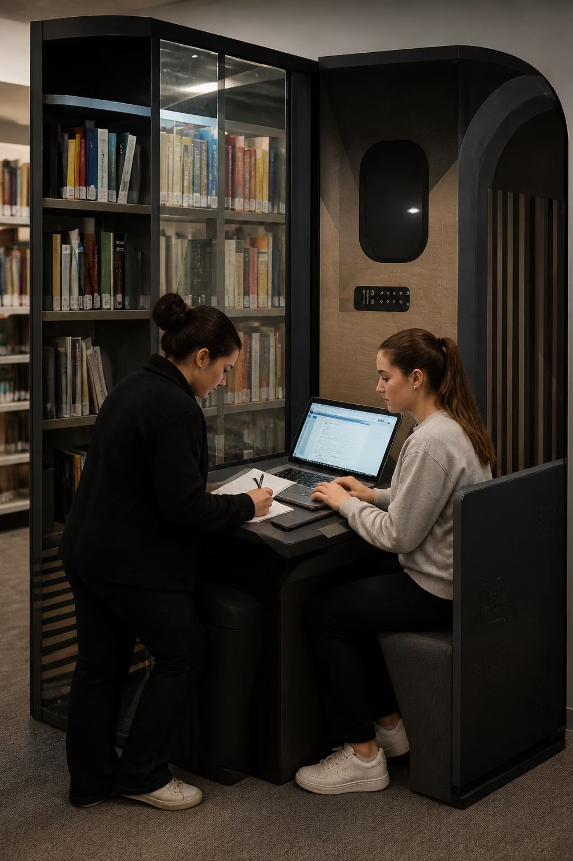
Business Value: Save Time. Cut Costs.
Faster Checkouts
Digital workflow vs. manual process
Always Available
Catalog access beyond open hours
Paper Records
Fully digitized book management

Slide 7
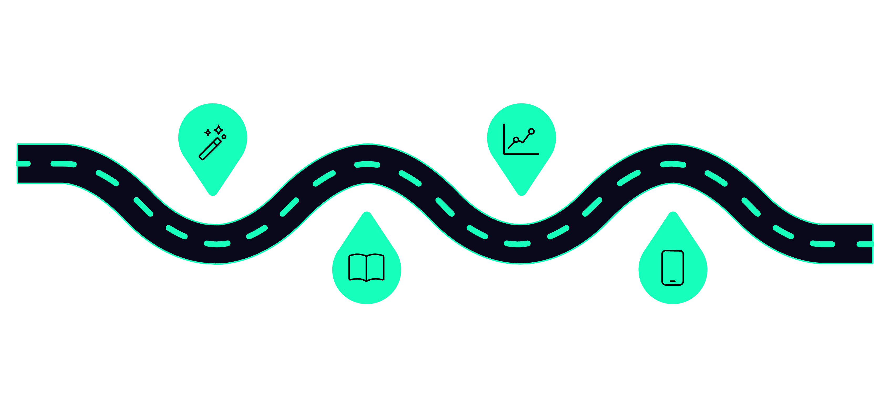
Future Roadmap: What's Next for ReadSpace
AI Recommendations
Analytics Dashboard
Personalized book suggestions from history
Admin insights on categories and peaks
Digital Content
Mobile App
E-books and audiobooks for hybrid reading
Push alerts and mobile borrowing
Each phase builds on the current foundation — scaling ReadSpace from a management tool into a complete intelligent library ecosystem.

Slide 8
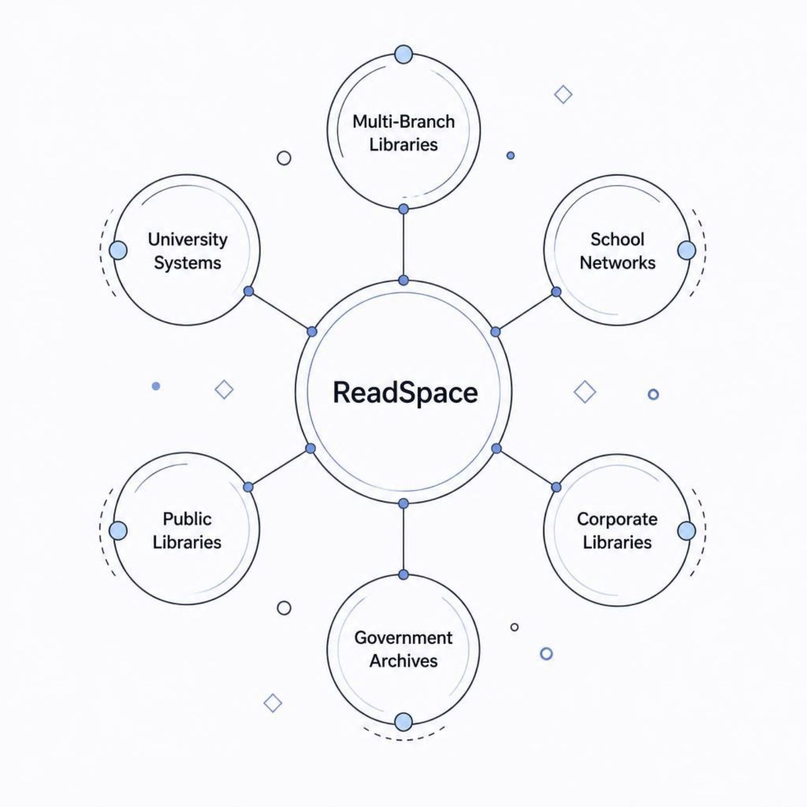



Scalability: Built to Grow With You
One System. Any Institution.
ReadSpace is architected to scale — from a single school library to a multi-branch university network.
🏫 Education
🏛 Public
🏢 Enterprise
Schools & universities
Municipal & community
Corporate & research

Slide 9

The Future of Libraries Starts Here
ReadSpace is more than a system — it's a commitment to smarter, faster, and more accessible library services.
🚀 Ready to Deploy
🤝 Let's Partner
Current features are production-ready
Pilots, partnerships & investment welcome
"Thank you for your time and attention; we are now ready to answer any questions you may have."

